Slide 1
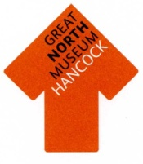
Team Quiz

Slide 2
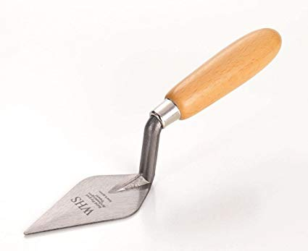
Round 1: Archaeology
What is archaeology?
What tool does an archaeologist use?
Name two metals which ancient Greek objects were made from.
Name something that survives very well in the archaeological record.
Name something that does not survive in the archaeological record.

Slide 3
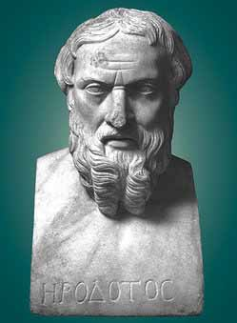
Round 2: Early Historians
Where was the idea of history first invented?
Which ancient Greek historian is called ‘the father of history’?
Which god helped Pheidippides?
Why did Pheidippides need help?
The ancient Greek historian Thucydides wrote about a famous war between Athens and which other city-state?

Slide 4
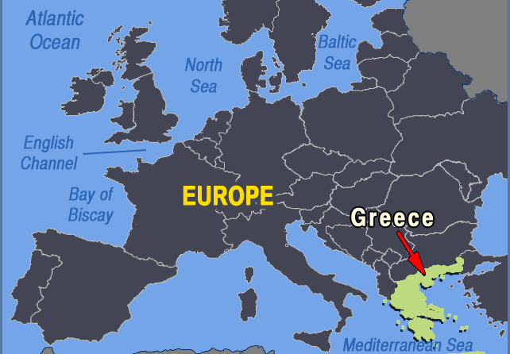
Round 3: Ancient Greece
What is epigraphy?
Name two places in mainland Greece.
Do ancient Greek dates end in BC or AD?
Where did the Minotaur live?
How would it be easiest to travel around the Greek world? By land or by sea?

Slide 5
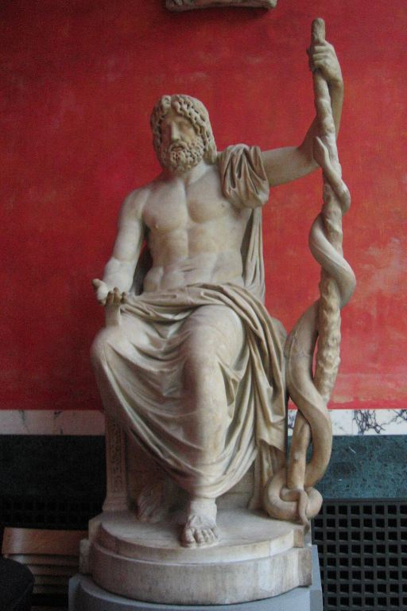
Round 4: Greek Religion
Who was the god of wine?
Who was the goddess of hunting?
What did Zeus hold?
What bird was associated with Athena?
What was the god of healing called?

Slide 6
Round 5: Myths and Heroes
Is a myth fact or fiction?
What was the Gorgon called?
Who killed the Gorgon?
What was the name of the winged horse?
Who was the biggest Greek hero?

Slide 7
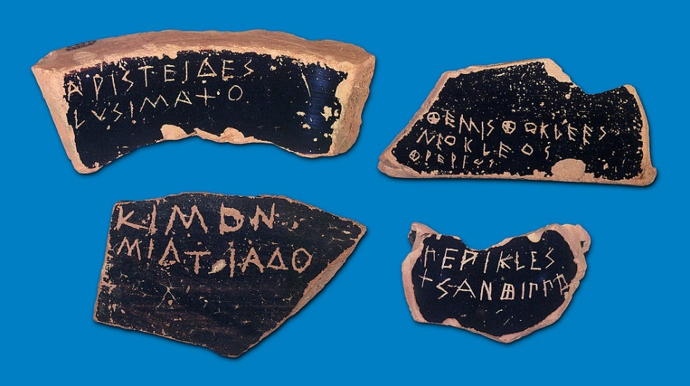
Round 6: Democracy
What was the Pnyx in Athens used for?
What is an ostrakon?
What does the word ‘democracy’ mean?
Who could not vote in ancient Athens?
What did members of the jury use to vote in ancient Athens?

Slide 8
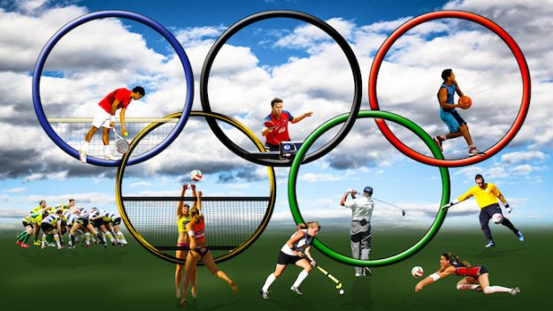
Round 7: Olympics
Name three events in the ancient Olympic Games.
What did Greek long jumpers hold to propel themselves forward?
What did Greek boxers use instead of gloves?
What did Greek athletes use olive oil for?
Which god’s statue was inside the big temple at Olympia?

Slide 9
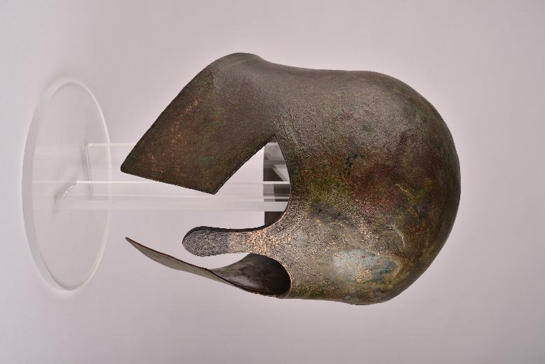
Round 8: Warfare
What is a hoplite’s shield called?
What two weapons does a hoplite carry?
What might you have a picture of on a Greek shield?
Which neighbouring Empire was the biggest threat to ancient Greece?
Name a piece of armour worn by hoplites.

Slide 10
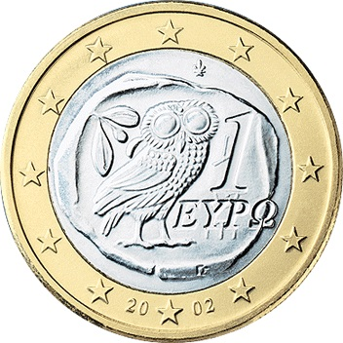
Round 9: Coinage
Name a metal Greek coins were made from.
Did all of the city-states in Greece have the same coins?
What bird appears on an Athenian coin?
Were coins made by hand or with a machine in ancient Greece?
Name a sea creature which appears on the coins of the Greek island of Aegina.

Slide 11
Round 10: Households
Name two things you might find in the andron of a Greek house.
Name two jobs women did in the home.
The Greeks did not have electric lights what did they use?
Name two toys a Greek child might have played with.
How do we know some Greek houses had a second floor?

Slide 12
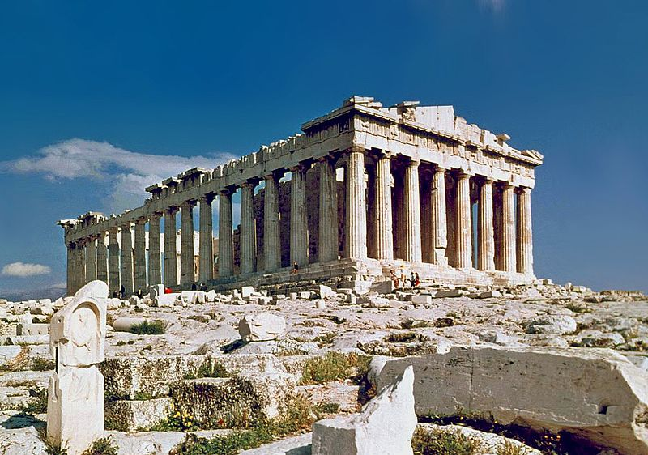
Round 11: Architecture
Name a type of Greek column.
What material did the ancient Greeks use to build temples?
Name a building in Newcastle influenced by ancient Greek architecture.
Why were Gorgon antefixes put onto temples?
What did the Greeks sacrifice to the gods?

Slide 13
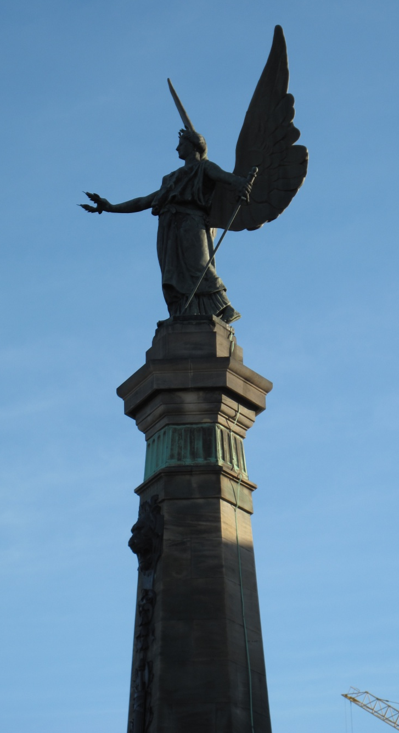
Round 12: Conclusion
Which Greek goddess can you see at Haymarket?
Who invented history?
Is the Olympic torch a modern invention?
Name an event from the modern Olympic Games which did not feature in the ancient Olympics.
Name two ancient Greek toys that children still play with today.

